Slide 1
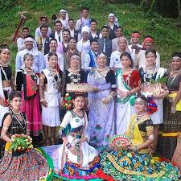
The tharu people live in the terai,a narrow strip of land which extends 550 miles of the southern border of Nepal.they have their own language,cultureand traditional beliefs.they were the only inhabitants of chitwan up until the late 1950s.
The tharu culture excursions offer you insight into the daily life of the tharu people. Many tharu think they should do everything in the western way and, by doing so, they abandon their own culture. These excursions aim to make the tharu feel proud of their culture again.

